Slide 1




The Role of TCD in PFO Diagnosis
and Management
S. Horner
Med. Univ. Graz, Department of Neurology, Graz, Austria
25th Meeting of the ESNCH,
Oct 15-17, 2021, Belgrade
no conflicts of interest related to this presentation

Slide 2

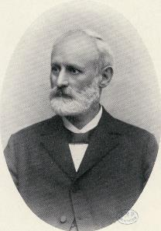
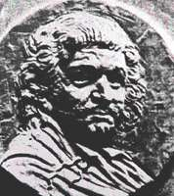
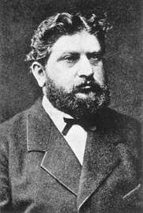
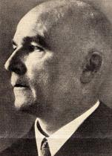
The Role of TCD in PFO Diagnosis and Management
Some Historic Milestones…
first illustration
of the PFO
first description
of the PFO
description of
paradoxical
embolism
first report of a
paradoxical
embolization
description of the
radiologic features
of an ASD
1513
1564
1877
1881
1921
Leonardo da Vinci
Leonardo Botallo
Julius Cohnheim
Friedrich Wilhelm Zahn
Herbert Assmann
„ I have found from a, left auricle,
to b, right auricle, like perforating channel from a to b “
S. Horner

Slide 3
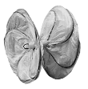
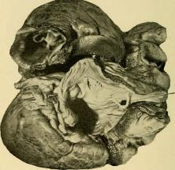

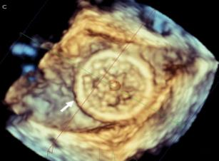
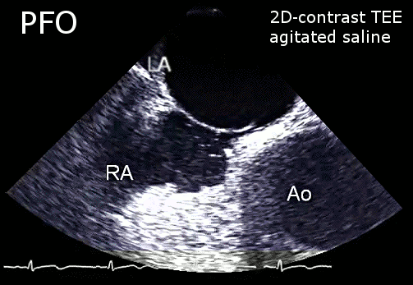
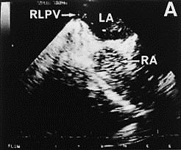
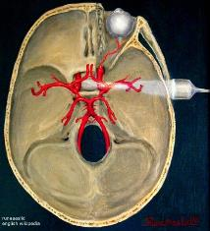
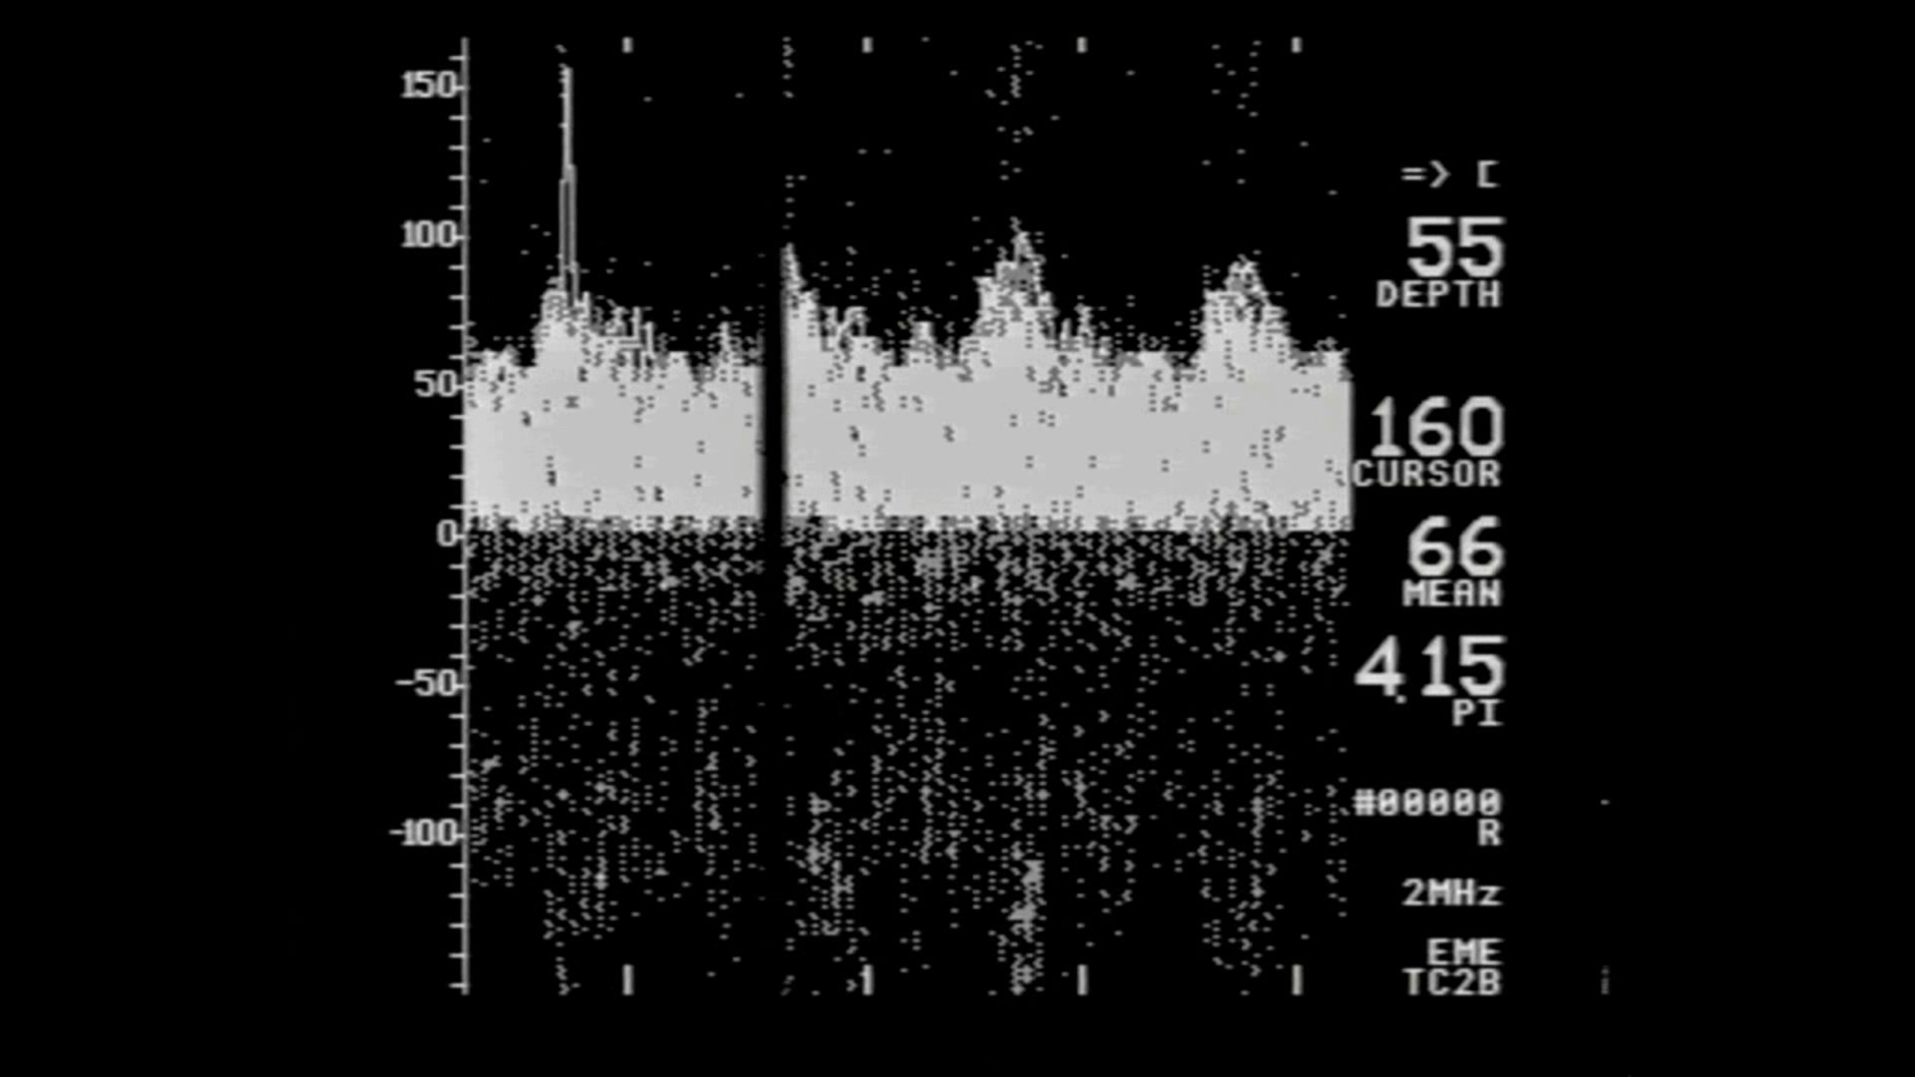
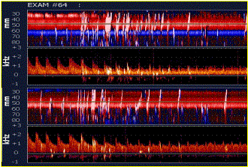
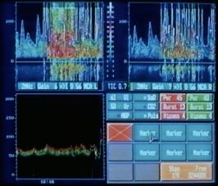
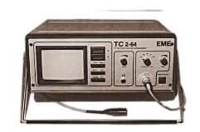
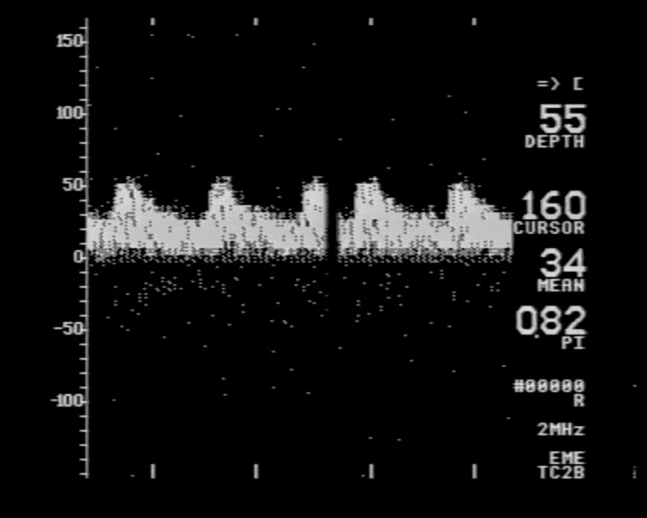
The Role of TCD in PFO Diagnosis and Management
autopsy
2D cTEE
3D TEE
1907
GCSO
Interventional Cardiology Review 2019;14(1)
cTCD
copyright S. Horner
S. Horner

Slide 4
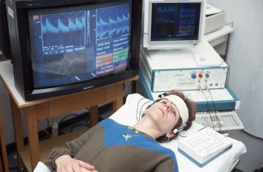
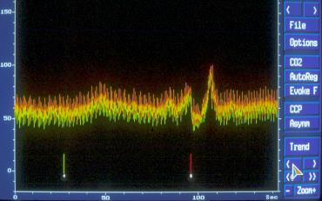
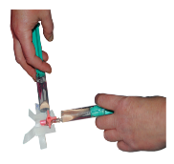
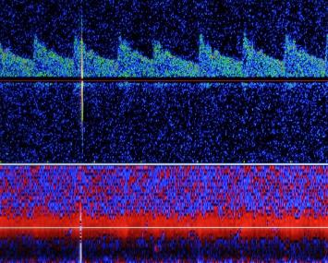
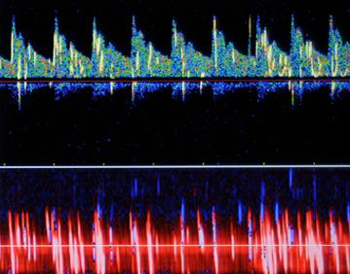
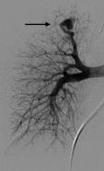
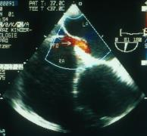
The Role of TCD in PFO Diagnosis and Management
Contrast agents
Oxypolygelatine
(Gelifundol®)
agitated saline
Echovist®
Detection of right-to-left shunt with ultrasound contrast agent and transcranial Doppler sonography.
Jauss M, Zanette EM for the Consensus Conference, Cerebrovasc Dis, 2000
S. Horner

Slide 5
The Role of TCD in PFO Diagnosis and Management
European Position Paper on the management of patients with patent foramen ovale. General approach and left circulation thromboembolism. Pristipino C et al, EuroIntervention 2019, European Heart Journal,+ 2021
European Society of Cardiology. ESC Guidelines for the management of adult congenital heart disease. Baumgartner H, De Backer J et al. European Heart Journal, 2021
American Heart Association/American Stroke Association. Guideline for the prevention of stroke in patients with stroke and transient ischemic attack. Kleindorfer D et al. Stroke, 2021
American Academy of Neurology (AAN). Practice Advisory Update: Patent Foramen Ovale and Secondary Stroke Prevention, Messé SR et al, Neurology, 2020
DGN /German Society of Neurology. Kryptogener Schlaganfall und offenes Foramen ovale, S2e-Leitlinie, in: Diener HC et al. Deutsche Gesellschaft für Neurologie (Hrsg.), Leitlinien für Diagnostik und Therapie in der Neurologie. Online: www.dgn.org/leitlinien. Nervenarzt, 2018
ÖGSF/Austrian Stroke Society Position Paper PFO – Update 2018. NeuroLogisch, 2018
S. Horner

Slide 6

The Role of TCD in PFO Diagnosis and Management
Management of Patent Foramen Ovale in ESUS Patients. Update 2021.
Major Key Points/Messages from the Guidelines
Primary stroke prevention: no medical/interventional therapy
Secundary stroke prevention/PFO closure if:
Age ≤ 60 (65) ys
Embolic- appearing ischemic stroke of otherwise unknown source
„High Risk PFO“:
PFO is associated with e.g. ASA
PFO is large / PFO is not small (< 2mm, < 6 Mb)
Interdisciplinary decision making for diagnosis and therapy
European Position Paper on the management of patients with patent foramen ovale. General approach and left circulation thromboembolism. Pristipino C et al, EuroIntervention 2019, European Heart Journal, 2021
European Society of Cardiology. ESC Guidelines for the management of adult congenital heart disease. Baumgartner H, De Backer J et al. European Heart Journal, 2021
American Heart Association/American Stroke Association. Guideline for the prevention of stroke in patients with stroke and transient ischemic attack. Kleindorfer D et al. Stroke, 2021
American Academy of Neurology (AAN). Practice Advisory Update: Patent Foramen Ovale and Secondary Stroke Prevention, Messé SR et al, Neurology, 2020
DGN /German Society of Neurology. Kryptogener Schlaganfall und offenes Foramen ovale, S2e-Leitlinie, in: Diener HC et al. Deutsche Gesellschaft für Neurologie (Hrsg.), Leitlinien für Diagnostik und Therapie in der Neurologie. Online: www.dgn.org/leitlinien. Nervenarzt, 2018
ÖGSF/Austrian Stroke Society Position Paper PFO – Update 2018. NeuroLogisch, 2018
S. Horner

Slide 7

The Role of TCD in PFO Diagnosis and Management
Management of Patent Foramen Ovale in ESUS Patients. Update 2021.
Major Key Points/Messages from the Guidelines
Primary stroke prevention: no medical/interventional therapy
Secundary stroke prevention/PFO closure if:
Age ≤ 60 (65) ys
Embolic- appearing ischemic stroke of otherwise unknown source
„High Risk PFO“:
PFO is associated with eg ASA
PFO is large / PFO is not small (< 2mm, < 6 Mb)
Interdisciplinary decision making for diagnosis and therapy
European Position Paper on the management of patients with patent foramen ovale. General approach and left circulation thromboembolism. Pristipino C et al, EuroIntervention 2019, European Heart Journal, 2021
European Society of Cardiology. ESC Guidelines for the management of adult congenital heart disease. Baumgartner H, De Backer J et al. European Heart Journal, 2021
Risk stratification
by cTCD
American Heart Association/American Stroke Association. Guideline for the prevention of stroke in patients with stroke and transient ischemic attack. Kleindorfer D et al. Stroke, 2021
American Academy of Neurology (AAN). Practice Advisory Update: Patent Foramen Ovale and Secondary Stroke Prevention, Messé SR et al, Neurology, 2020
DGN /German Society of Neurology. Kryptogener Schlaganfall und offenes Foramen ovale, S2e-Leitlinie, in: Diener HC et al. Deutsche Gesellschaft für Neurologie (Hrsg.), Leitlinien für Diagnostik und Therapie in der Neurologie. Online: www.dgn.org/leitlinien. Nervenarzt, 2018
ÖGSF/Austrian Stroke Society Position Paper PFO – Update 2018. NeuroLogisch, 2018
S. Horner

Slide 8
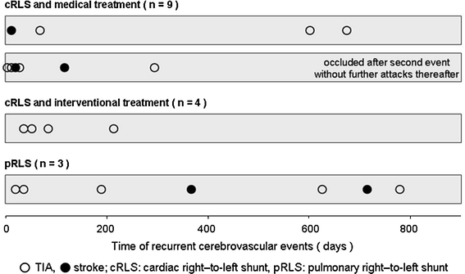
The Role of TCD in PFO Diagnosis and Management
Risk stratification criteria by cTCD
First-line test to detect a RLS during the acute phase of ischemic stroke workup and ultrasonography for timely decision to perform cTEE
TACET
• prospective not randomized
national (15 sites) registry
• 201 pts (188 CS)
• recurrences for Stroke/TIA all:
1.3% / 4.3%
The patient with angiographically confirmed pulmonary fistula had 2 stroke and 2 TIA recurrences
Time course of the recurrent cerebrovascular events. Most recurrent CVEs in patients with cRLS occurred soon after the index event
Horner S, Niederkorn K, Gattringer T, Furtner M, Topakian R, Lang W, Maier R, Gamillscheg A, Fazekas F. Management of right-to-left shunt in cryptogenic cerebrovascular disease: results from the observational Austrian paradoxical cerebral embolism trial (TACET) registry. J Neurol 2013:260;260-267
S. Horner

Slide 9
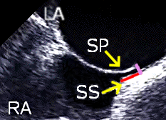
The Role of TCD in PFO Diagnosis and Management
Risk stratification criteria by cTEE
High-Risk PFO
The important factors that determine the significance of a PFO are its size and the degree of a right-to-left shunt.
TEE defines PFO size as the maximal height of separation between the septum primum and secundum. The physiological shunt size of a PFO is determined by the number of bubbles that cross the PFO.
PFO sizes and shunt severity, ASA, atrial septal hypermobility, presence of Chiari network or Eustachian valve can be linked to a causal role of PFO. European position paper on the management of patients with patent foramen ovale. General approach and left circulation thromboembolism. Pristipino C et al. European Heart Journal 2018, EuroIntervention 2019
In most studies, size is an independent risk factor for stroke occurrence and recurrence with OR of 2.54 when the size is ≥ 2 mm. Nakayama R et al, Identification of high-risk patent foramen ovale associated with cryptogenic stroke: development of a scoring system. J Am Soci Echocardiogr, 2019
RCTs comparing PFO Closure vs Medical Therapy
RESPECT CLOSE GORE-REDUCE DEFENSE-PFO
2017 2017 2017 2018
large (grade 3) > 30 > 30 > 25 IC: ≥ 2 mm
moderate (grade 2) 10-20 6-25
small (grade 1) 1-5
S. Horner

Slide 10
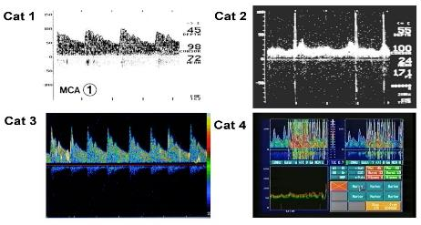
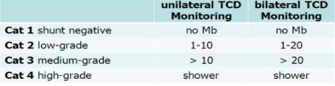
The Role of TCD in PFO Diagnosis and Management
Risk stratification criteria by cTCD
cTCD
Routine TEE reports often lack of a detailed description of the PFO anatomical size and exact amount of contrast shunted
• functional relevance
• permanent/functional RLS
• extent of shunting
• alternative tool for diagnosis of successful ´ interventional treatment
Anatomical grading may not always be equivalent to its functional grading
Clinical criteria strongly suggest paradoxical cerebral embolism but TEE assessed PFO size is small
mean PFO height
TEE vs ICE 1.4 ± 0.6 vs 1.7 ± 0.6 mm p=.04
TEE vs SB 1.5 ± 1.2 vs 10.5 ± 4.2 mm p<.0001
ICE vs SB 1.7 ± 0.7 vs 9.1 ± 3.7 mm p<.0001
A comparison of methods to determine patent foramen size. Kumar P et al, Catheterization and Cardiovascular Interventions, Dez 2019
S. Horner

Slide 11

The Role of TCD in PFO Diagnosis and Management
Management of Patent Foramen Ovale in ESUS Patients. Update 2021
Stroke-PFO Registry Graz
Med. Univ. Graz, Austria, Department of Neurology
• Data documentation of patients selected: • interdisciplinary (cardiologist, neurologist) for PFO closure
• during monthly performed PFO conferences
• established in 2002
• n = 696 (as of Sept. 23rd, 2021), ongoing
S. Horner

Slide 12
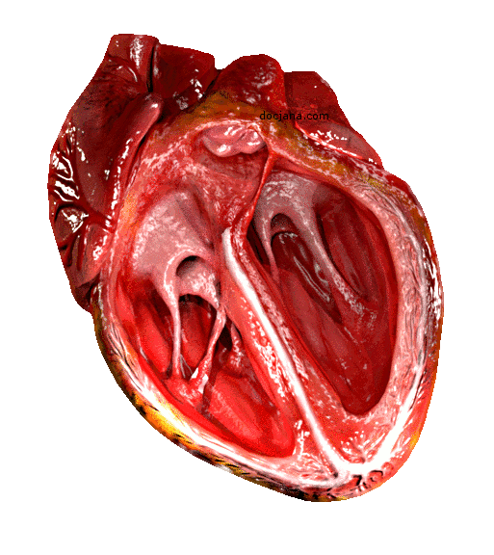
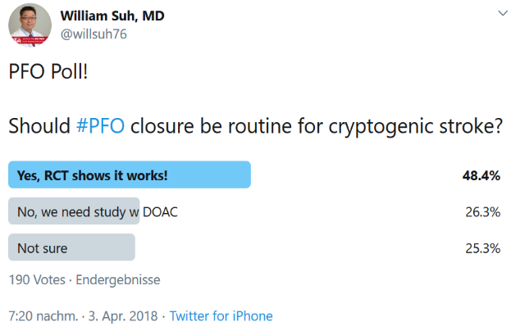
The Role of TCD in PFO Diagnosis and Management
Management of Patent Foramen Ovale in ESUS Patients. Update 2021
# Guidelines and the Real World ?
CardioTwitter
Interventional Cardiologist
What kind of therapy would you choose for yourself ?
28. Sept. 2017 200 votes
CLOSURE
72%
OAC
20%
Antiplatelets
9%
S. Horner

Slide 13
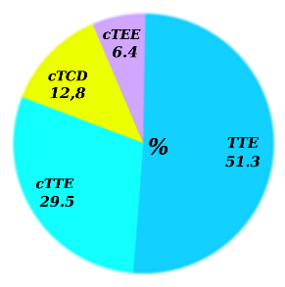
The Role of TCD in PFO Diagnosis and Management
Management of Patent Foramen Ovale in ESUS Patients. Update 2021
# Guidelines and the Real World ?
ESC/EACVI Survey 2021
Sensitivity Specificity
% %
TEE 89 92
TTE 46 99
TCD 97 93
• Worldwide survey - 79 imaging centers, 34 countries
• to evaluate the current practice for assessment and
management of patients with PFO and stroke
First-level test in
cryptogenic stroke
Meta-Analysis. Mojadidi MK et al, 2014, 27 studies,
1968 pts. PFO Closure for Cryptogenic Stroke. Singh HS et al, Cardiology in Review, 2017
• TCD available: 71%
• TCD first-line imaging:
only 13% !
c-TCD has a higher sensitivity than c-TTE as a first-line investigation to detect a R-T-L shunt
Level of Evidence A
European position paper on the management of patients with patent foramen ovale. Pristipino C
et al. EuroIntervention 2019
EACVI survey on the management of patients with patent foramen ovale
and cryptogenic stroke. D´Andrea A et al. European Heart Journal –
Cardiovascular Imaging, 2021
S. Horner

Slide 14

The Role of TCD in PFO Diagnosis and Management
Finally, I´d like to highlight again that:
Interdisciplinary approach for a rational PFO management based on the best available evidence is recommended.
However, TCD is still less frequently used in the management
of PFO mediated stroke and in clinical practice.
Further effort is required to teach and practice the TCD examination technique at centers and international meetings.
ESNCH participants are always one step ahead ☺
S. Horner

